Slide 1
Interim FSS Internal Flow Paths
Logan Negherbon, PE
CENWP-EC-HD
12/5/2017

Slide 2
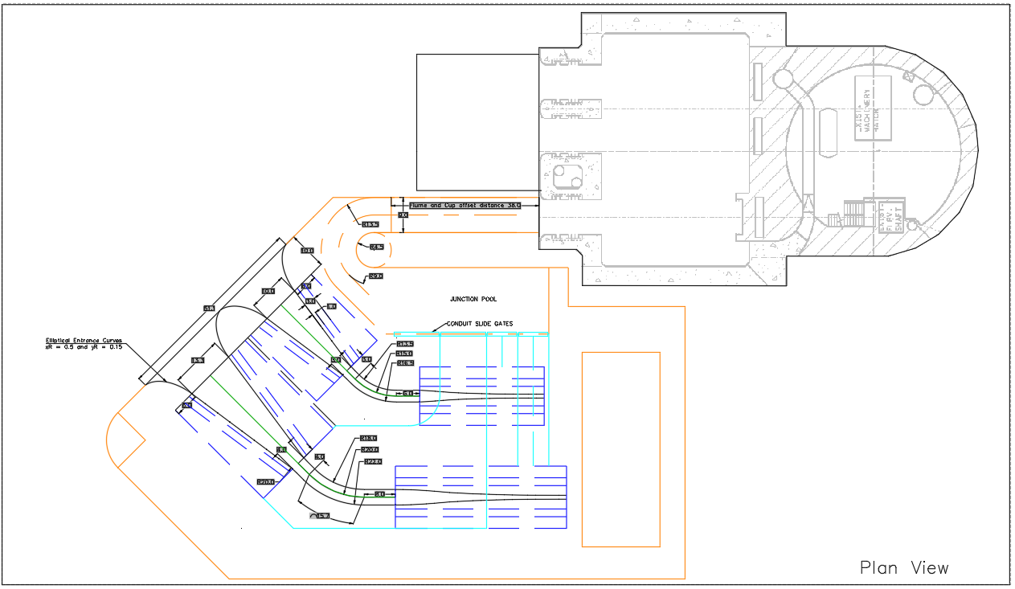
Interior Collection Channel
Exterior Collection Channel

Slide 3
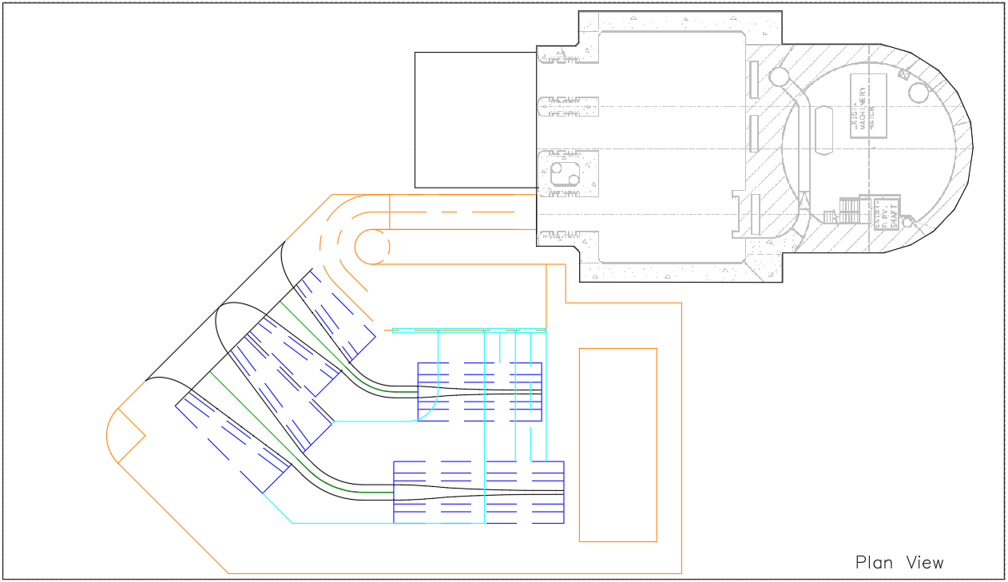
Flow passes through the primary screens into the down wells
Interior Collection Channel
Exterior Collection Channel

Slide 4
Flow passes through the secondary screens into the down wells

Slide 5
Flow from the down wells mix below the screens

Slide 6
Flow below the primary screens pass through the respective screen plenums

Slide 7
Flow below the secondary screens pass through the respective screen plenums

Slide 8
Flow from the plenums enter the junction pool and then passes through the bend and flume into the wetwell

Slide 9
Section A
Section B

Slide 10
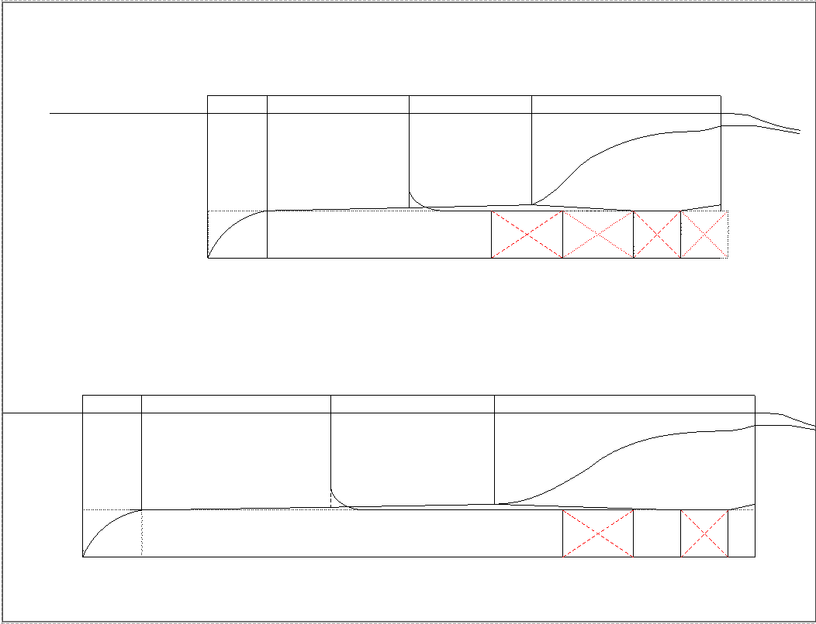
Section A
Int. Primary Screen
Int. Secondary Screen
Section B
Ext. Primary Screen
Ext. Secondary Screen

Slide 11
Section A
Int. Primary Screen
Int. Secondary Screen
Section B
Ext. Primary Screen
Ext. Secondary Screen

